Slide 1


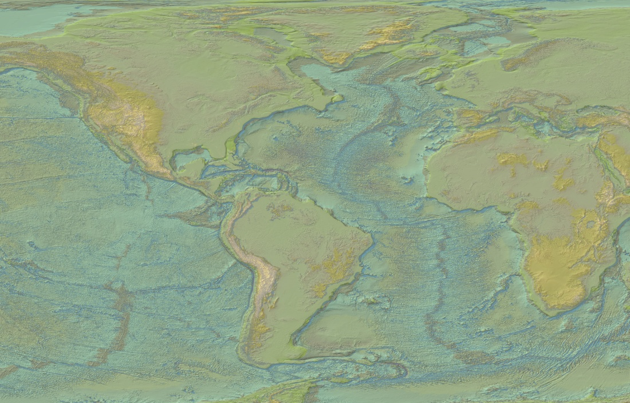
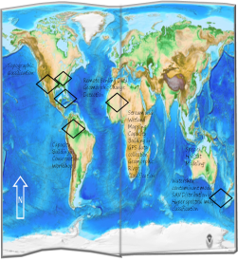
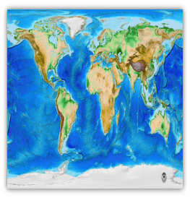
∫
GAIA SPATIAL
Informing Integrative Perspectives
Gaia Spatial, LLC is a GIS and Remote Sensing consultancy specializing in integrative geospatial analysis to inform environmental conservation and sustainability research and management. Geospatial analysis fosters
integrative perspectives of biological,
physical and social system interrelationships
by framing ecological and biophysical theories
within site specific, multi-scalar landscape
context.
Home
Approach
Services
Projects
About
Contact Gaia Spatial, LLC

Slide 2
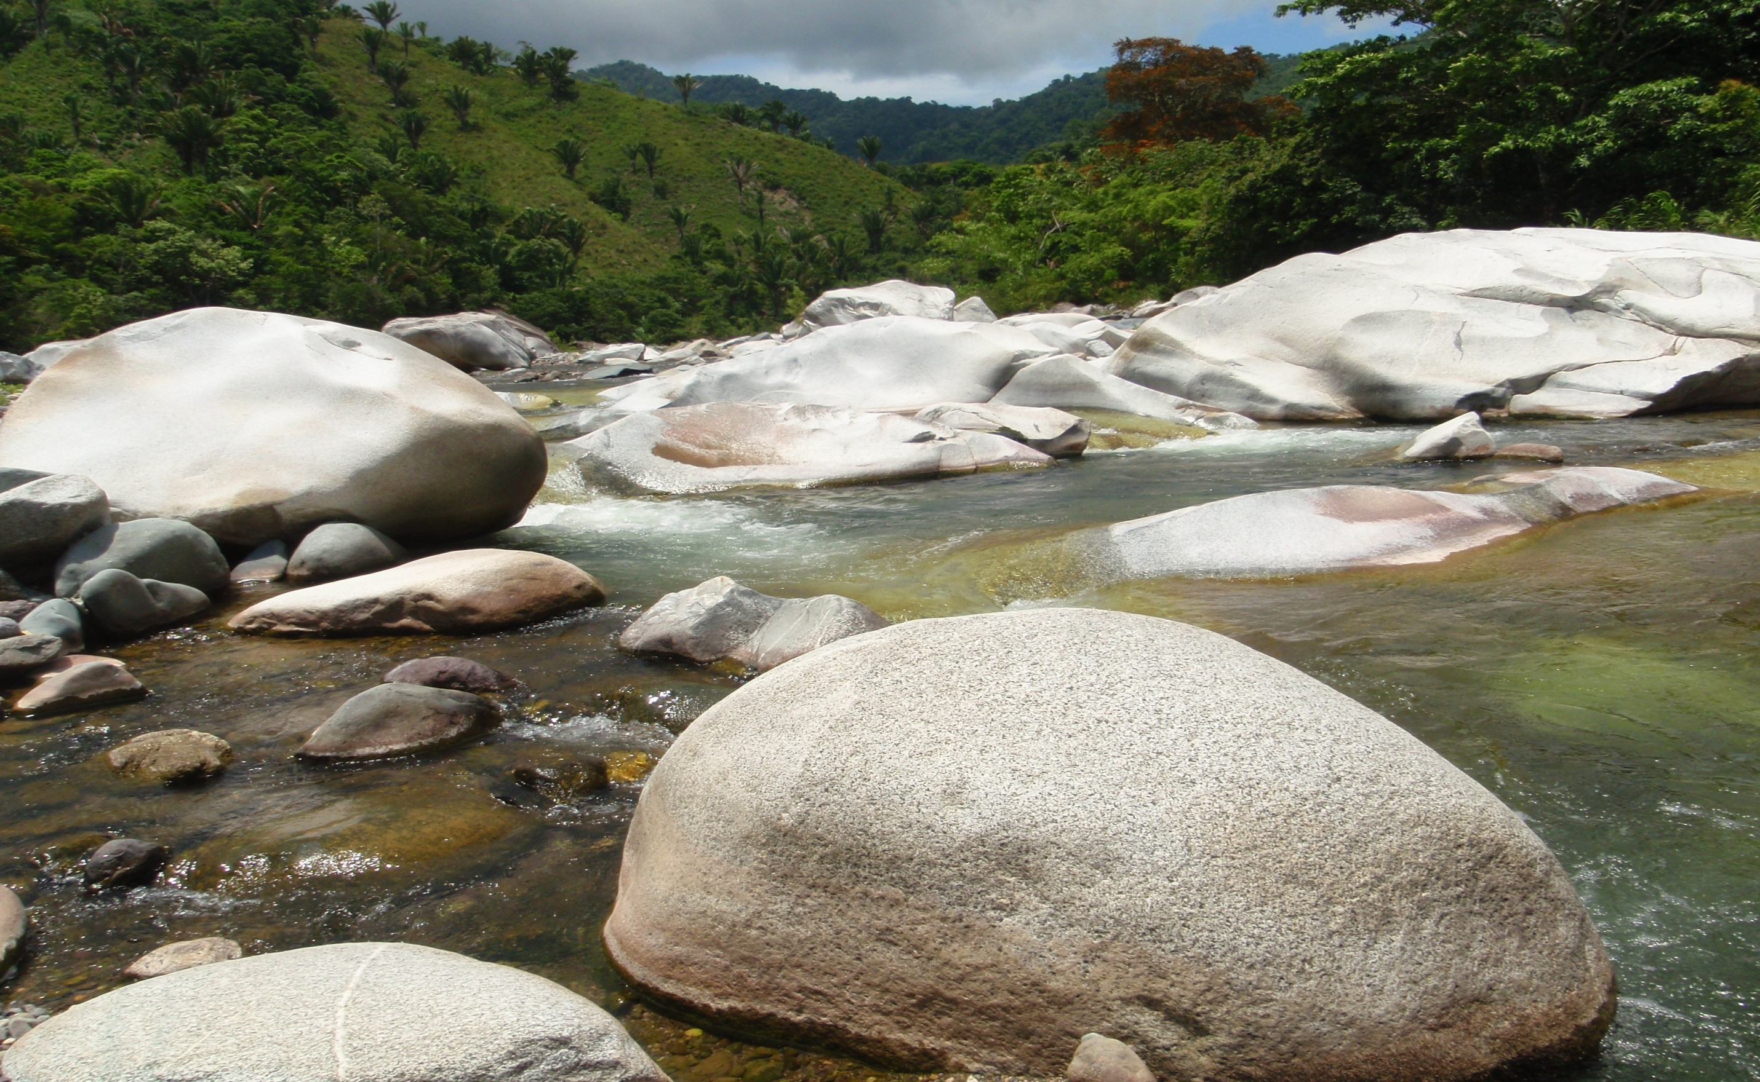
∫
GAIA SPATIAL
Informing Integrative Perspectives
Gaia Spatial, LLC is a GIS and Remote Sensing consultancy specializing in integrative geospatial analysis to inform environmental conservation and sustainability research and management. Geospatial analysis fosters
integrative perspectives of biological,
physical and social system interrelationships
by framing ecological and biophysical theories
within site specific, multi-scalar landscape
context.
Home
Approach
Services
Projects
About
Contact Gaia Spatial, LLC

